Slide 1
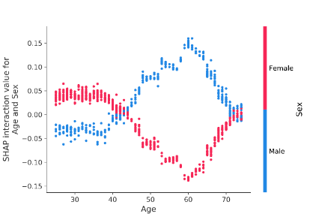

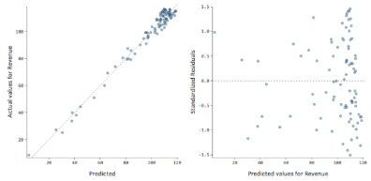
Team Objectives
Build a distributed machine learning pipeline in Pandas and Dask using gigabytes of retail data from a large retail company. The final deliverable will be a presentation in Jupyter / PowerPoint describing your approach, modeling techniques, and final results.
1
2
3
4
Load data from a .pkl into Jupyter notebook running on an Amazon EC2 instance
Explore the data and generate new features for modeling
Build a tuned modeling pipeline to produce accurate forecasts
Interpret the results and write a summary for a non-technical audience
Training Data
Predictions
AWS EC2

Slide 2
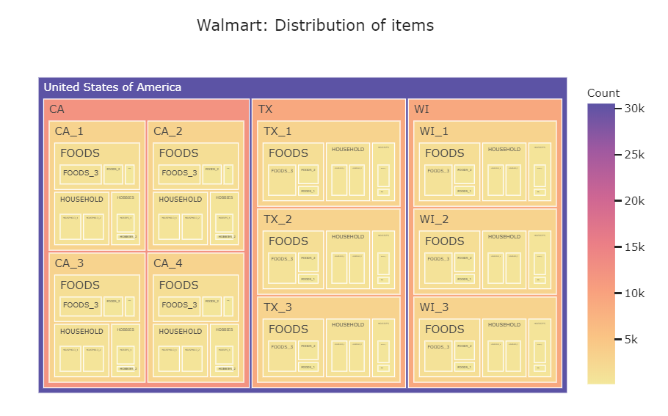
Data Overview
The dataset we’ll be using is real, historical Walmart data taken from the M5 Forecasting Competition on Kaggle. The data was briefly cleaned and aggregated to the week level to reduce sparsity.
About the M5 Competition
Purpose is to advance the theory of forecasting and improve its utilization by business and non-profit organizations
Preeminent forecasting competition in the academic world
First competition (now called the M1) took place in the 1980’s)
Latest competition (M5) closed just last week
Data Overview
Hierarchical sales data from Walmart, the world’s largest company by revenue
Covers stores in three US States (California, Texas, and Wisconsin)
Includes item level, department, product categories, and store details
See the Word doc below for details:
More EDA available here

Slide 3
Team Expectations
Rules of the Road
Things We’ll Learn
Machine learning is a team sport; be respectful of others’ contributions and code reviews
Try to fix your own bugs, but don’t be afraid to ask for help if you get stuck
Commit early, commit often with useful descriptions
Show up on time and ready to walk-through your code
Update the Trello board before each Zoom meeting
Everyone will present the weekly status update at least once
Accomplishments
Roadblocks
Decisions Needed
Next Steps
Real-world software engineering skills
CI/CD basics
Writing good tests
Automating them with GitHub Actions
Functional programming basics, including taking advantage of first-class objects
Writing fast, efficient python code
Machine learning skills
Feature engineering
Algos (XGBoost, LightGBM)
Validation (and how not to do it)
Collaborating with other programmers on GitHub and Trello

Slide 4






Guiding Principles & Technology Stack
Guiding Principles
Tech. Stack
1
Other teams do things; we build things
Languages / Frameworks
2
Encourage continuous feedback and code reviews; we’re all here to learn
3
Eliminate unnecessary meetings and PMO activities (“Talk less, do more”)
Task Management Platform
4
Proactively manage technical debt (beware the “broken window” theory)
Collaboration Tech.
5
Minimize our collective WTF’s per minute (next slide)
6
Automate your tests for reuse (short-term pain => long-term gain)
Data Hosting Service

Slide 5
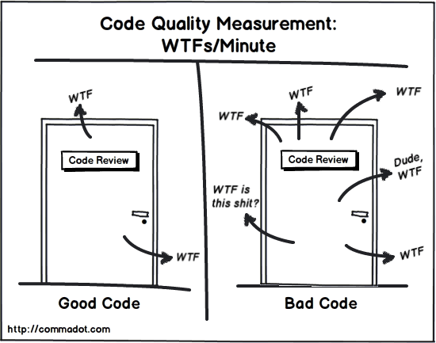
Minimizing WTF’s Per Minute: Guidelines from Clean Code
All object names should be descriptive and meaningful
Long names are fine if that’s what it takes to make them descriptive (can easily search for names using tab key)
Objects / vectors / tables should be lower-case nouns [e.g., training_df]
Methods / functions should start with verbs [e.g., get_file_path()]
Comments should only be included as a last resort when your code isn’t expressive enough
Comments are always failures; they suggest that you haven’t found a way to express yourself using code
When writing a comment, ask yourself: can I refactor my code or change variable / function names to clearly express what I’d want to convey in a comment?
Unused code is to be deleted, not commented out
If you’re worried about losing a piece that you may need later, commit a new change in GitHub, delete the unwanted code, and then commit a new change
The vast majority of data transformations should sit within expressively-named functions
Makes code easier to follow
Enables us to test each piece independently
Allows us to quickly locate and fix broken code in production
Avoids having interim tables take up valuable RAM
All functions should do one and only one thing and contain no more than 3 parameters maximum
Functions should be as small as possible
If you have a function longer than 5 lines, you probably should split it up until multiple functions
No hardcoding, period
Anything hardcoded should be in the parameters table at the beginning of the script
Minimize the number of for() and while() loops used in each script
Spark internals are designed to simplify your code on the back-end as long as you avoid UDFs

Slide 6

Appendix: “Hacker Laws”

Slide 7
(source)
“Hacker Laws” (1 of 3)
 | Summary | Implications
Amdahl's Law | Parallelization increases processing speed according to a hyperbolic tangent curve | There’s a drastic speed difference between something that’s 95% parallelized and something that’s only 50%
The Broken Windows Theory | Visible signs of crime or lack of care increases the odd for future crime / disorderliness | Be intolerant of bad code
Brooks' Law | Adding human resources to a late development project makes it later | Staff the team right from the beginning. Focus on quality, not quantity, of DB practitioners
Conway's Law | Technical boundaries of a system will reflect the structure of the organization that built it | Use a client-server model for powering other use cases. Don’t bolt-on new applications.
Dunbar's Number | We can only keep so much in memory | Refactor early and often. Write simple systems. Ruthlessly cut deprecated code.
Gall's Law | Highly-complex systems are more likely to fail | Write clean, tight functions. Limit dependency between modules.
Goodhart's Law | When a measure becomes a target, it ceases to be a good measure. | Be vigilant about overfitting.
Hofstadter's Law | It always takes longer than expected. | Be careful not to over scope engagements. Leave room to breathe so you can cover the team if disaster strikes.
Hutber's Law | Improvements to a system will lead to a deterioration in other parts of that same system. | Limit dependencies between modules. Ensure you’re constantly rerunning the pipeline during development to avoid upstream issues.
The Hype Cycle & Amara's Law | We overestimate tech. in the short-run and underestimate in the long-run. | Be purposeful when building your roadmap to describe exactly what the team will / will not do. Avoid scope creep caused by tech. hype.

Slide 8
(source)
“Hacker Laws” (2 of 3)
 | Summary | Implications
Hyrum's Law (The Law of Implicit Interfaces) | As your number of users scale, you should expect all attributes of your API to be used. | Test all of your code.
Kernighan's Law | Debugging is twice as hard as writing the code in the first place. | Write simple, not clever code. Make it as easy to read as possible.
Murphy's Law / Sod's Law | Anything that can go wrong will go wrong. | Test all of your code.
Occam's Razor | Prefer simple solutions. | Write simple code. If something feels complicated, ask yourself if there’s an easier way to think about it
Parkinson's Law | Work expands so as to fill the time available for its completion | Timebox efforts to 3-5 hours per week. Work smarter, not harder.
Premature Optimization Effect | Premature optimization is the root of all evil. | Get it to work and write the test before you worry about optimizing.
Putt's Law | Management often necessarily doesn’t understand technical details. | Simplify your messaging. Partner with people who have different strengths than you do.
Reed's Law | The utility of large networks scales exponentially with the size of the network | Build a big, diverse team
The Law of Conservation of Complexity (Tesler's Law) | Some complexities cannot be reduced. | Don’t make the user journey more complex by making the code easier.
The Law of Leaky Abstractions | All non-trivial abstractions introduce bugs. | Be sure your abstractions are necessary.
The Law of Triviality | People tend to spend more time on trivial or cosmetic issues than on substantial ones | Be judicious with your time. Avoid unnecessary PMO like the plague

Slide 9
(source)
“Hacker Laws” (3 of 3)
 | Summary | Implications
The Pareto Principle (The 80/20 Rule) | 80% of value comes from 20% | Work with leadership to identify the 80% of value we should be going after
The Robustness Principle (Postel's Law) | Be conservative in what you do, be liberal in what you accept from others | Avoid using rigid functions. Understand that most users will try to enter weird objects as inputs
The Single Responsibility Principle | Every module should only do one thing. | Write simple code. Don’t try to do too much in one function
The Open/Closed Principle | Interfaces should be open for extension but closed for modification | Write extensible functions (e.g., take other functions as parameters). Try not to be too prescriptive.
The DRY Principle | Don’t repeat yourself | Don’t write the same code more than once. Use functions and variable effectively
The KISS principle | Keep it simple. | Do everything you can to fight complexity
YAGNI | Only build functionality your users are asking for. | Try to avoid pursuing ideas that aren’t explicitly being asked for by someone (either a PMD or a client)
The Fallacies of Distributed Computing | Distributed computing offers many advantages but also some unforeseen consequences | Educate the team on Spark to help them solve known issues, particularly OOM failures and latency limitations

